Slide 1


SermonLingo
Live translation
for your church
Live captions and translated AI voice
on the phones your guests already have.
A guide for pastors, ministry leaders and volunteers
SermonLingo
01
Notes:
SermonLingo helps churches provide live translated captions and optional AI voice. This guide covers the guest experience, service setup, production features, costs and a first rehearsal. Sources: src/config/site.ts, src/config/pricing.ts. Artwork: existing public/images/dove-daylight.webp; logo: public/images/brand/sermonlingo-logo.png. Prices checked September 28, 2026.

Slide 2
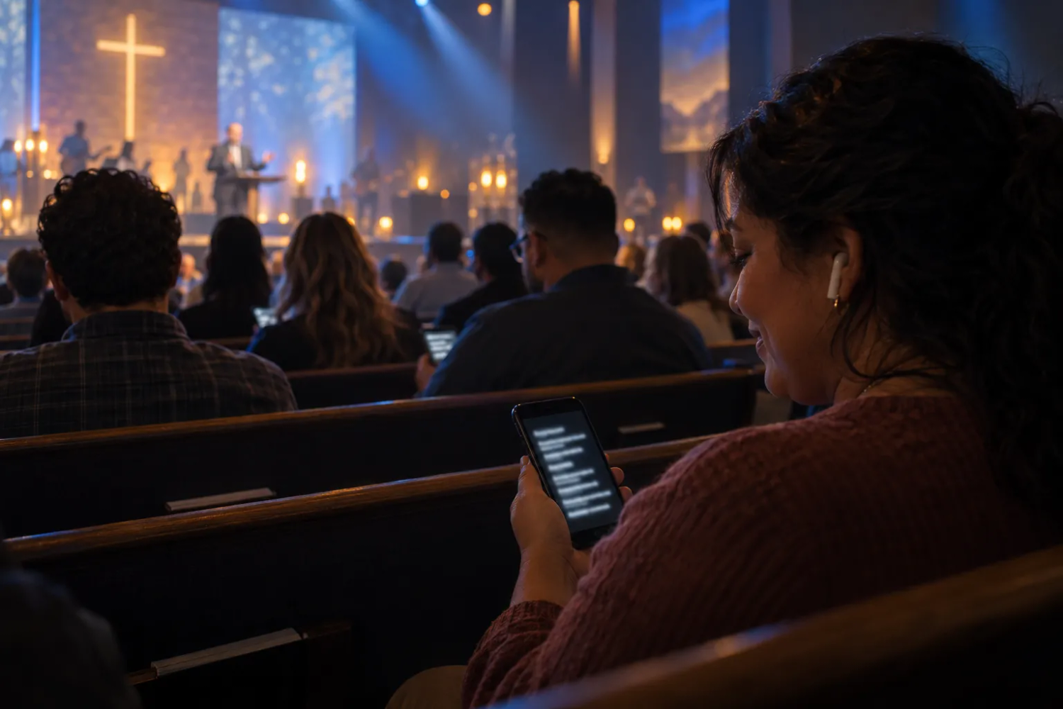
One service, more people included
Guests can follow the message in a language they understand.
For multilingual congregations
Offer live captions in 50+ languages.
Choose the languages for each service,
then let each guest select their own.
For guests who prefer listening
AI voice is available in 13 live voice
languages on eligible plans. Guests
can listen with their own headphones.
Illustrative scene
SermonLingo
02
Notes:
Sources: src/config/languages.ts lists 54 caption languages and 13 live speech-to-speech voice languages. src/config/pricing.ts includes translated AI voice from Standard. Same-language captions can support guests who prefer reading. Feature availability depends on the plan, enabled languages and service configuration. Image is an existing website illustration, not a customer photograph or product screenshot: public/images/scene-sanctuary.webp.

Slide 3
How guests join
A browser link or QR code opens the service on their phone.
01
Open the service
The welcome team shares the service QR code or listener link.
Guests do not need to install an app or create an account.
02
Choose a language
Each guest selects a language offered for that service.
They can switch languages while following the message.
03
Read or listen
Live captions appear on the phone. Where AI voice is enabled,
guests tap Listen and use headphones to avoid room noise.
SermonLingo
03
Notes:
Sources: src/components/realtime/public-listener-feed.tsx, src/config/languages.ts, src/components/console/service-setup-dialog.tsx. Use the QR code generated for the actual service. Listening requires a user gesture in supported browsers. Audio is AI-generated. No decorative QR code is presented as a working destination.

Slide 4
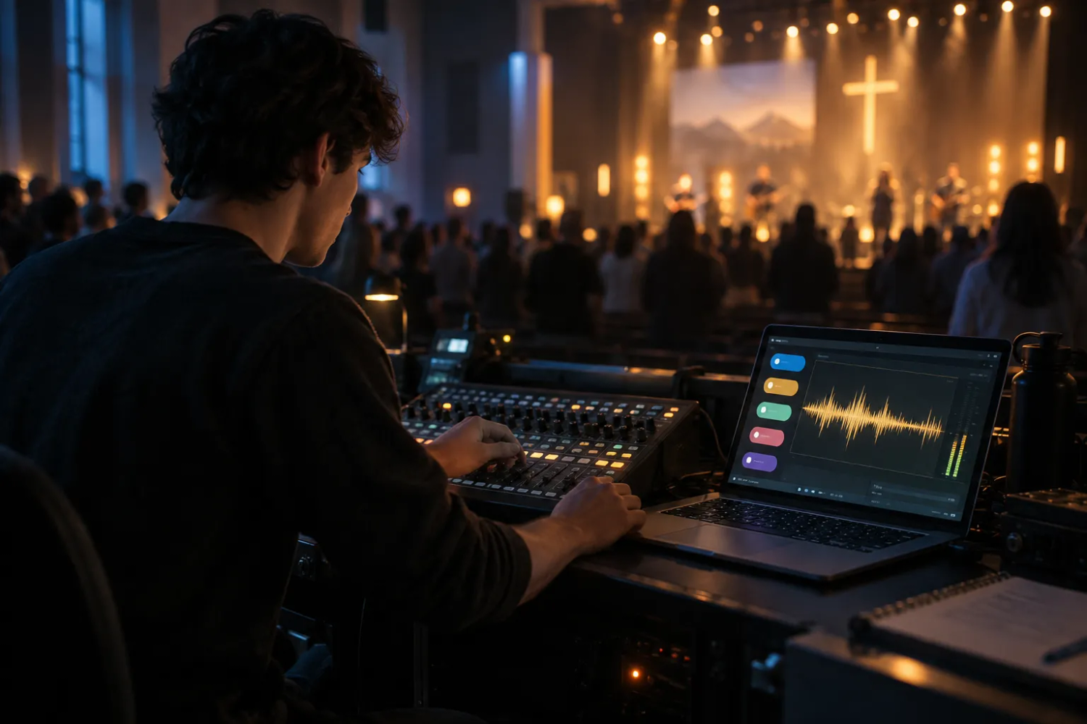
A service your volunteers can run
A laptop, internet connection and a clean speech feed are the starting point.
01
Prepare the service
Choose the speaker language and
the languages your guests need.
02
Check the audio
Select the microphone or mixer input.
Test normal speech on a second device.
03
Monitor the service
Start translation, watch the captions,
and stop when the service ends.
Illustrative audio setup
SermonLingo
04
Notes:
Sources: src/components/console/service-setup-dialog.tsx, src/components/console/live-stage.tsx and mic-check.tsx. A mixer connection may require a suitable audio interface or cable. Test the actual room and network before a service. Production requires a connected translation backend. Artwork: public/images/scene-booth.webp, an illustration rather than a real customer setup.

Slide 5
Preparation and reuse
Advanced includes glossary and transcript tools for the ministry team.
A shared church glossary
Notes and subtitle drafts
Add names, scripture terms and preferred
translations before the service. Import a
.txt file and export it for another volunteer.
Search captions in each captured language.
Export TXT or CSV for notes, or SRT and
WebVTT for captions on recorded video.
One entry per line. Up to 200 terms.
Save imported terms before going live.
Review wording before publication. Align
subtitle timing with the recording.
Captured transcripts support follow-up work. Keep human review in your publishing process.
SermonLingo
05
Notes:
Sources: src/components/console/glossary-input.tsx, glossary-transfer.ts, history-panel.tsx and history-export.ts. Glossary import accepts .txt up to 100 KB, 200 terms and 80 characters per term. Imported terms remain a draft until saved. Exports contain captured captions for available languages, not a guaranteed complete recording transcript. SRT and WebVTT use caption commit times relative to the first exported caption, so timing must be aligned to the actual recording. Plan source: src/config/pricing.ts.

Slide 6
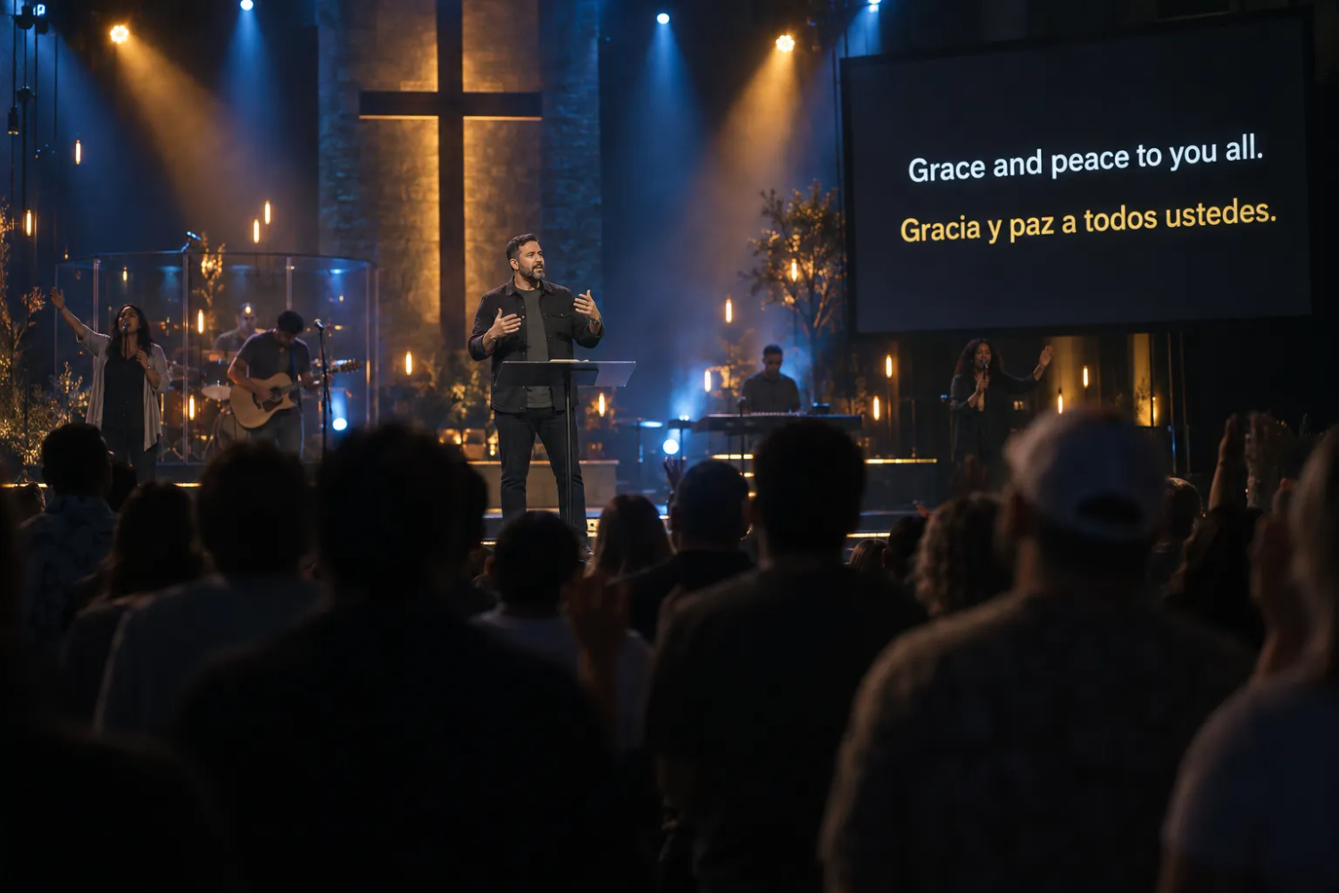
Screens and livestreams
Translation can reach guests in the room and viewers online.
Stage display and overlays
Show up to four languages on a screen.
Use the caption overlay with OBS or vMix.
Stage display and OBS overlay start
with the Standard plan.
Production connections
Advanced adds stream input and webhooks.
Connect your encoder over RTMP or SRT,
and test the integration before the service.
Illustrative service scene
SermonLingo
06
Notes:
Sources: src/components/console/integrations-section.tsx, src/app/display/[serviceId]/page.tsx, src/app/embed/[serviceId]/page.tsx, src/config/pricing.ts and docs/STREAM_INGEST.md. Stage display can show up to four languages. Encoder ingest requires deployment of the configured stream-ingest gateway and credentials. Feature listing is not a claim that every church has integrations configured. Artwork: public/images/scene-stage.webp, an illustrative scene.

Slide 7
Plans for different service needs
Unlimited listeners on every plan. Translation time counts for each language.
Plan | Price and allowance | Selected capabilities
Pay As You Go | $5 per hour per language | 50+ caption languages QR code and listener link
Standard | $99 / month 25 translation hours | AI voice, stage display and OBS overlay Additional translation hours: $4 each
Advanced | $299 / month 100 translation hours | Glossary, transcripts, RTMP and webhooks Additional translation hours: $3 each
Premium | $499 / month 250 translation hours | Custom branding and simultaneous rooms Additional translation hours: $2 each
USD list prices, before applicable taxes. Confirm current pricing and plan access before purchase.
SermonLingo
07
Notes:
Source: src/config/pricing.ts and src/config/site.ts, checked September 28, 2026. Standard includes 25 translation hours at $99/month with $4 overage, Advanced 100 at $299 with $3 overage, Premium 250 at $499 with $2 overage. Pay As You Go captions cost $5 per hour per target language. Premium setup is arranged with the team. These are selected capabilities, not an exhaustive feature matrix.

Slide 8
A monthly budget example
Four services with a 45-minute sermon in two target languages.
4 services × 45 minutes × 2 languages
6 translation hours
6 hours × $5 = $30 on Pay As You Go
This example covers captions. Include rehearsals, announcements and other speech
in your monthly estimate. Choose a voice plan if guests also need translated audio.
SermonLingo
08
Notes:
Illustrative monthly estimate from published Pay As You Go pricing: 4 × 45 ÷ 60 × 2 = 6 translation hours, multiplied by $5 per translation hour = $30 before taxes and trial credit. This does not include rehearsal time or other spoken content, and does not include a voice plan. Sources: src/config/pricing.ts and src/components/home/pricing/estimate.ts.

Slide 9
A rehearsal before the first Sunday
Use the actual audio setup and invite a fluent speaker for each target language.
01
Audio
Check the microphone or mixer feed at normal speaking levels.
02
Language quality
Check scripture, names and meaning with fluent speakers.
03
Guest experience
Test the service QR code, captions and any enabled voice.
04
Volunteer handoff
Practice starting, pausing, resuming and stopping the service.
05
Fallback
Agree how the team will respond if audio or internet fails.
The trial includes 4 translation hours shared across languages.
A 30-minute rehearsal in two languages uses 1 translation hour.
SermonLingo
09
Notes:
Trial source: src/config/pricing.ts freeTrialHours = 4. The allowance is total translation time, not four hours for each language. A 30-minute rehearsal with two active target languages consumes 60 translated minutes. Trial eligibility depends on the account. Rehearsal steps are operational recommendations. Automated translation should be checked by fluent speakers.

Slide 10
The next step for your church
One rehearsal can answer the questions that matter before a wider rollout.
01
Try the listener experience
On the SermonLingo website, choose Try it on your phone.
The scripted demo shows how a guest reads and listens.
02
Prepare a rehearsal
Choose Start free. Create one service, select the target languages
and name a volunteer to run the audio check.
03
Review and decide
Check language quality with fluent speakers and review the budget.
Use Book a demo if your team needs help with the setup.
SermonLingo
10
Notes:
Destinations in the SermonLingo site navigation: Try it on your phone opens /live/demo, Start free opens /app, Book a demo opens /demo, and current pricing is at /pricing. The public domain has not been configured in this repository, so this guide uses the exact website navigation labels instead of an unverified URL. The free trial provides four total translation hours. Human interpreters may still be needed for sensitive or high-nuance situations.

